Slide 1
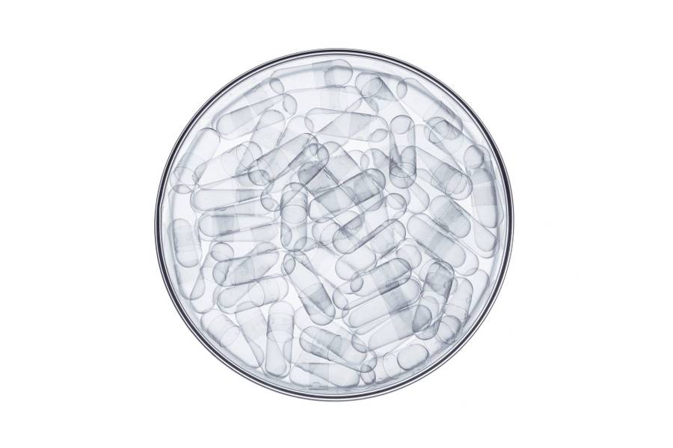
MDCN: Modified Dense Convolution Network based brain tumor classification
MIRJAM NILSSON​

Slide 2


Meet our team
Chirag Chandrashekar
20BAI1298
M
Deepak
20BAI1162

Slide 3

Agenda
Introduction
Literature Survey
Proposed Methodology
Experimentation
Conclusion

Slide 4

Introduction
According to the 2016 reclassification by the World Health Organization (WHO), a brain tumor pertains to abnormal growth in the central nervous system, resulting in a decline in brain tissue size and disruption to the neural network. Brain tumors, categorized as cancerous or non-cancerous (benign and malignant), manifest in areas like meningioma, glioma, and pituitary, each varying in malignancy. Initial assessments by oncologists utilize medical imaging, particularly Magnetic Resonance Imaging (MRI) and Computed Tomography (CT) scans, to detect structural changes. Surgical biopsy may be required for detailed diagnosis if a brain tumor is suspected, with advancements in imaging technologies enhancing contrast and resolution for accurate identification.

Slide 5
Challenges Faced
However, challenges persist, and its efficacy in specific tasks, such as brain tumor classification, warrants exploration. Brain tumors exhibit diverse characteristics, and accurately classifying and detecting them using algorithms presents several challenges:
Data Imbalance
Overlapping Symptoms
Image Quality and Diversity
Ambient Noise
Incomplete Data
Computational Complexity

Slide 6
main contributions and novelty of the proposed algorithm
MDCN integrates the synergy of transfer learning and advanced data loader techniques, leveraging pre-trained models and streamlining the data ingestion process for optimal transmission.
Advanced optimizer techniques ensure that MDCN converges efficiently, reducing training times and enhancing robustness.
While building on the DenseNet architecture, MDCN introduces innovative modifications to enhance the network's ability to capture and differentiate subtle features of various brain tumors.
MDCN achieves an impressive accuracy of 96.51% in detecting and classifying brain tumors, setting a new benchmark when compared to traditional and state-of-the-art algorithms.

Slide 7

Literature Survey

Slide 8
Papers
Title | Journal Name | Year of publication | Method | Dataset URL | No.Of Images used | Advantages | Limitations | Remarks
Brain tumor MRI images identification and classification based on the recurrent convolutional neural network | Sciencedirect | 2022 | 1st step - removing noise using adaptive filtering algorithm, 2nd step - segmentation using improved k-means clustering(IKMC) algorithm, 3rd step - feature extraction using gray-level co-occurrence matrix(GLCM) and finally using RCNN for classification | https://www.kaggle.com/sartajbhuvaji/brain-tumor-classification-mri | 2870 (4 classes-Glioma,Meningioma,Pituitary and healthy) | using noise reduction and segmentation improved the accuracy of model
Classification of Brain Tumors from MRI Images Using a Convolutional Neural Network | MDPI,Switzerland | 2020 | A generic CNN model's performance is compared when original and augmented datasets are feeded into it, also they used record-wise and subject wise 10-fold cross validation | Via hospital | 3064 (3 classes-Glioma,Meningioma and Pituitary) | By using augmented dataset, the results are improved. | Amount of original data | The dataset used is taken from another research where 233 patients records are unified and de-identified
Classifying Brain Tumors on Magnetic Resonance Imaging by Using Convolutional Neural Networks | MDPI,Switzerland | 2023 | Comparision of CNN and few pretrained models with 5-fold cross validation | https://figshare.com/articles/dataset/brain_tumor_dataset/1512427 | 7023 (4 classes-Glioma,Meningioma,Pituitary and healthy) |  | Amount of original data | Few other datasets are used but they are currently unavailiable/removed
Classification of Brain MRI Tumor Images Based on Deep Learning PGGAN Augmentation | MDPI,Switzerland | 2021 | 3 models, namely, VGG19+CNN, VGG19+GRU, VGG19+Bi-GRU, are used to compare results while using classical Data augmentation and PGGAN to increase the size of dataset |  | 3064 (3 classes-Glioma,Meningioma and Pituitary) | Using data augmentation, especially PGGAN, to increase the dataset, solving the data deficency problem, has boosted the learning capability of models and increase the accuracy | Amount of original data | The dataset used is taken from another research where 233 patients records are unified and de-identified
Explainable Convolutional Neural Networks for Brain Cancer Detection and Localisation | MDPI,Switzerland | 2023 | Using Grad-CAM algorithm on top of normal CNN model | https://www.kaggle.com/datasets/ahmedhamada0/brain-tumor-detection | 3000 (1500 - healthy, 1500 - brain tumor) | By using Grad-CAM algorithm, the region of image used to make decision can be identified, helps in modifications, interpretation and explainability of model
Brain Pathology Classification of MR Images Using Machine Learning Techniques | MDPI,Switzerland | 2023 | After preprocessing input images, segmentation using fuzzy clustering means and thresholding(FCMT) and morphological operations are done on the input and classification is done using CNN. Also after segmentation and morphological changes, HOG and LBP combinational feature extraction is applied and then it is fed into SVM classifier. These 2 models are used and compared | https://www.scidb.cn/en/detail?dataSetId=faa44e0a12da4c11aeee91cc3c8ac11e and other datasets | used different datasets for CNN and SVM, and also for training and testing, actual number is not availiable | by using the combination of HOG and LBP feature extractors, SVM performed better that when LBP or HOG is used alone. Also, by applying segmentation and morphology operations CNN performed better |  | No.of images used and all the datasets used aren't specified exactly in the paper

Slide 9
Papers - Continued
Brain Tumor Detection Based on Deep Learning Approaches and Magnetic Resonance Imaging | MDPI,Switzerland | 2023 | modified YOLO-V7 is used (YOLO-V7 + Convolutional Block Attention Module(CBAM) attention mechanism + Spatial Pyramid Pooling Fast+ (SPPF+) + Bi-directional Feature Pyramid Network (BiFPN) + decoupled head (DP)) | https://www.kaggle.com/datasets/masoudnickparvar/brain-tumor-mri-dataset https://www.kaggle.com/datasets/sartajbhuvaji/brain-tumor-classification-mri | 10,288 | By coupling Yolo-V7 with other modules, the model performance is increased drastically | Addition of other modules made it more complex and increased computational parameters
MRI-Based Effective Ensemble Frameworks for Predicting Human Brain Tumor | MDPI,Switzerland | 2023 | Feature extraction using CNN, used as input for different ML algorithms(DT,XG-Boost,KNN,RF,ada-boost). Then in proposed model, top-3 classifiers are used and a voting system is employed to determine the output | https://figshare.com/articles/dataset/brain_tumor_dataset/1512427 | 3762 | By using voting of top classifiers to get final output, increased the chances of correct prediction
Object Detection for Brain Cancer Detection and Localization | MDPI,Switzerland | 2023 | YOLO-V8 | https://universe.roboflow.com/yolo-hz3ua/yolo-fj4s3 | 300 | Rather than using large datasets compared to DL models, YOLO requires medium or less dataset | Inorder to train the model we need to annotate the dataset, which requires man power and time
Brain Tumor Segmentation from MRI Images Using Handcrafted Convolutional Neural Network | MDPI,Switzerland | 2023 | Using HOF and DSURF feature extractors, features are extracted and are integrated into CNN model. Then finally model is fine-tuned to adjust with integrated data | BraTS2018 | 285 patients records () |  | The complexity of the integration strategy is Large, annotated datasets and tuning is huge
An Augmented Modulated Deep Learning Based Intelligent Predictive Model for Brain Tumor Detection Using GAN Ensemble | MDPI,Switzerland | 2023 | Brain tumor image data is augmented using a GAN ensemble(using different GAN's), which is fed for classification using a hybrid modulated CNN technique. The outcome is generated through a soft voting approach to identify best GAN architecture gives best results | https://figshare.com/articles/dataset/brain_tumor_dataset/1512427/5 | 3064 | As data augmentation is done, the model will have better generalisability
. Performance analysis of machine learning algorithm of detection and classification of brain tumor using computer vision | Sciencedirect | 2022 | an experiment for performance computation of numerous ML algorithms for effective categorization of brain tumors | https://www.oasis-brains.org/ |  |  | Selection of the ideal features for recognition of the diverse classes seems to be a more complex as well as time taking procedure due to the lack of generalization possibilities
A novel extended Kalman filter with support vector machine based method for the automatic diagnosis and segmentation of brain tumors | Sciencedirect | 2020 | Model ensemble an Extended Kalman Filter (EKF) as well as Support Vector Machine (SVM) to categorize brain tumors in MR images. Finally, automatic segmentation method based on the combination of k-means clustering and region growth is used for detecting brain tumors. | Via hospital | 120 patient records | Better classification performance and effective segmentation | approach is computationally more complex as we are using region-growing algorithms
Brain tumor detection in MR image using superpixels, principal component analysis and template based K-means clustering algorithm | Sciencedirect | 2021 | Initially, the important features were extracted utilizing the super pixels as well as principal component analysis (PCA), then followed by Template K-means clustering based segmentation | https://www.kaggle.com/datasets/navoneel/brain-mri-images-for-brain-tumor-detection | 40 | Template k-means algorithm provides better results than k-means | Lower classification accuracy | inaddition to given dataset they used another dataset prepared by themselves
Brain tumor segmentation of MR images using SVM and fuzzy classifier in machine learning | Sciencedirect | 2022 | Grey Level Run Length matrix (GLRLM) is used for feature extraction, classification is done using SVM algorithm. If tumor is detected, then using fussy c-means clustering algorithm along with other optimisation algorithms to segment the tumor | not mentioned exact source | 210 | improved analysis | This framework is less robust to alter different settings, namely slice thickness, imaging parameters, slice, contrast, etc.

Slide 10

Proposed Methodology

Slide 11
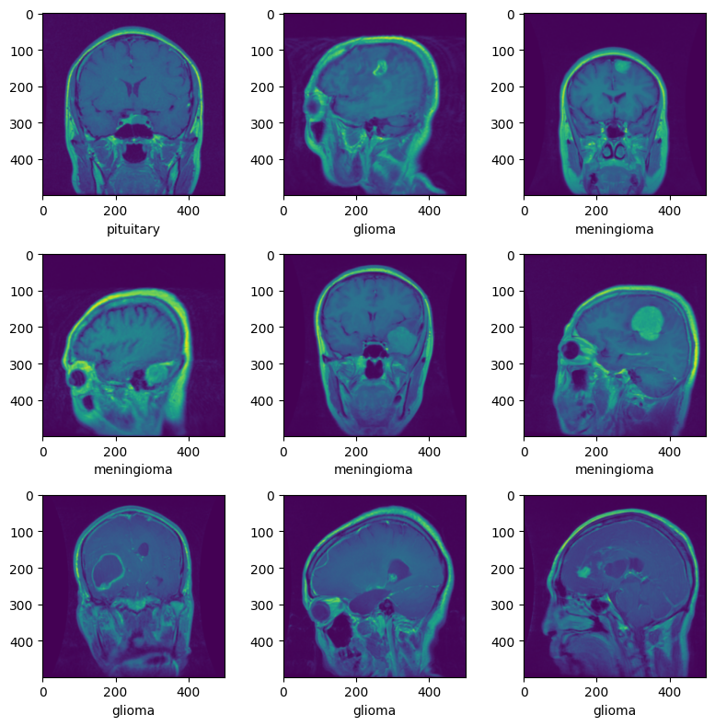

Brain Tumor image dataset
The comprehensive diagnosis and detection of brain tumors necessitate a dataset of considerable richness and depth, meticulously curated and assembled from the BrainTumorBD Dataset. Boasting a total of 4,205 images, this dataset presents an exhaustive portrayal of three different brain tumor ailments. Intriguingly, among these, 3100 images depict distinct individual tumor, offering a glimpse into the breadth and diversity inherent in real-world scenarios. Noteworthy among these are diseases such as meningioma, glioma, and pituitary conditions. Each of these three categories comprises 1400 images, ensuring a well-balanced representation. The ensuing figure provides a visual representation of brain tumor samples from specific classes within the dataset, with each image sized pixel of 500 x 500 dimensions.

Slide 12
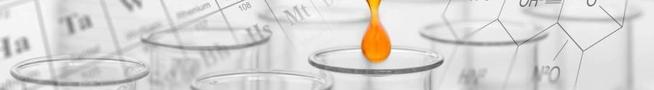
Different Techniques Used
Transfer-learning
MDCN
Fine tuning
Evaluation
Comparison
Using CNN
Based on the architecture of densenet-128
Using concepts like early stopping and dropout
Using methods like Accuracy, Precision, Recall, F1 score
Compared with algorithms like Resnet, VGG, Traditional Densenet and CNN

Slide 13
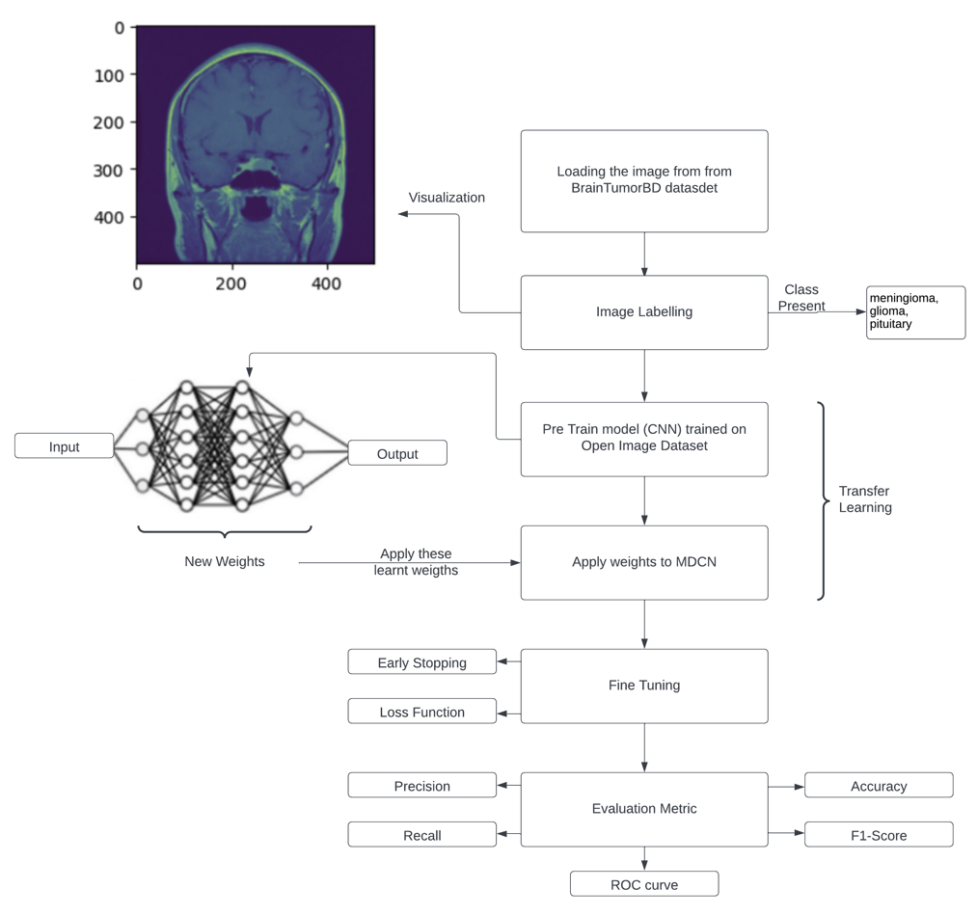
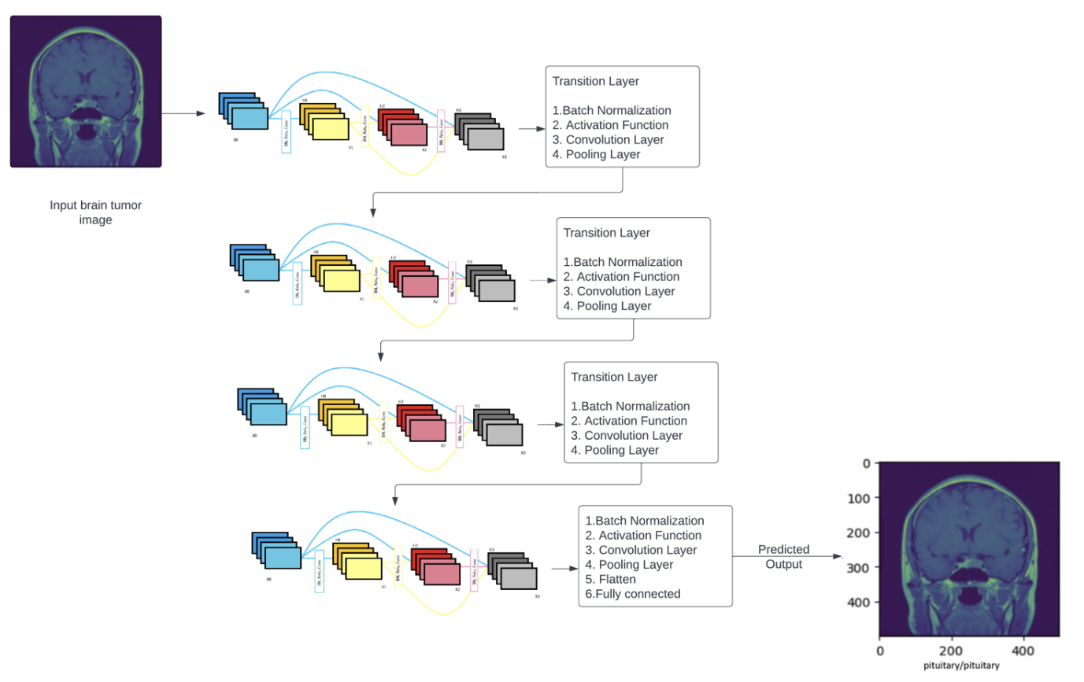
Propose Model Architecture

Slide 14
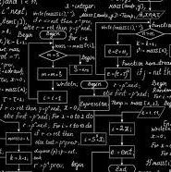



Experimentation
Data Visulation
Discussion
Comparison

Slide 15
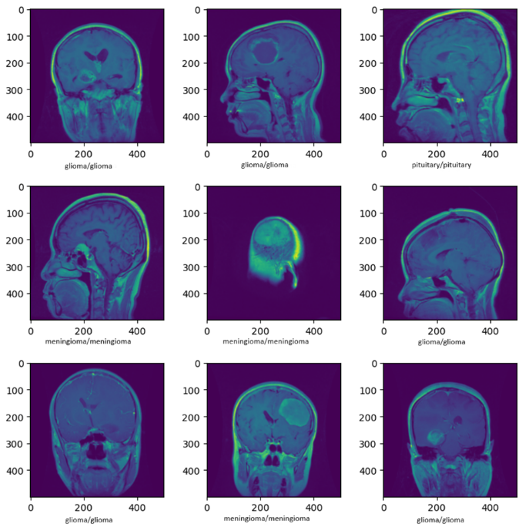
Image Visualization
Besides identifying the image's class-label, the image visualization function will also display the image marked with its predicted class. Once this process is done, the results can be seen as illustrated in the corresponding figure.

Slide 16
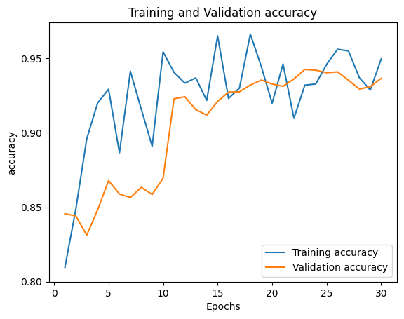
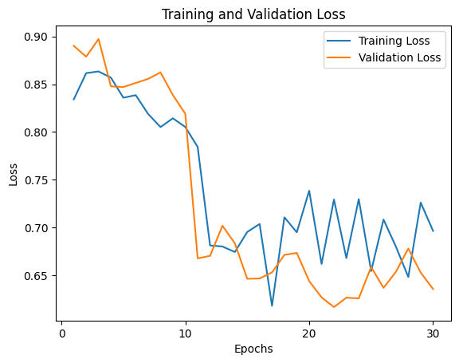
Accuracy and Loss Graph – 30 Epochs
The performance metrics of the model, namely accuracy and loss over 30 epochs, are illustrated in the corresponding diagram.

Slide 17
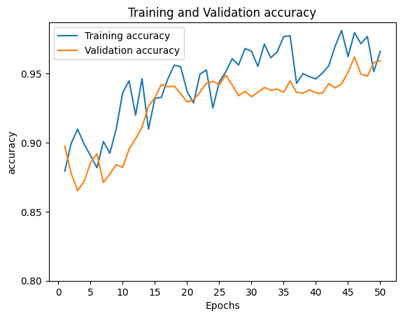
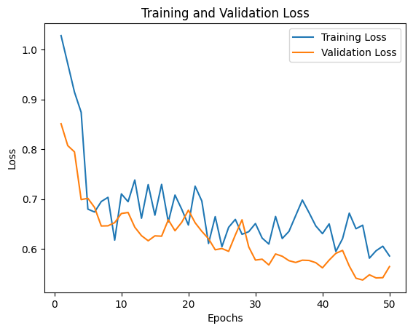
Accuracy and Loss Graph – 50 Epochs
The performance metrics of the model, namely accuracy and loss over 50 epochs, are illustrated in the corresponding diagram.

Slide 18
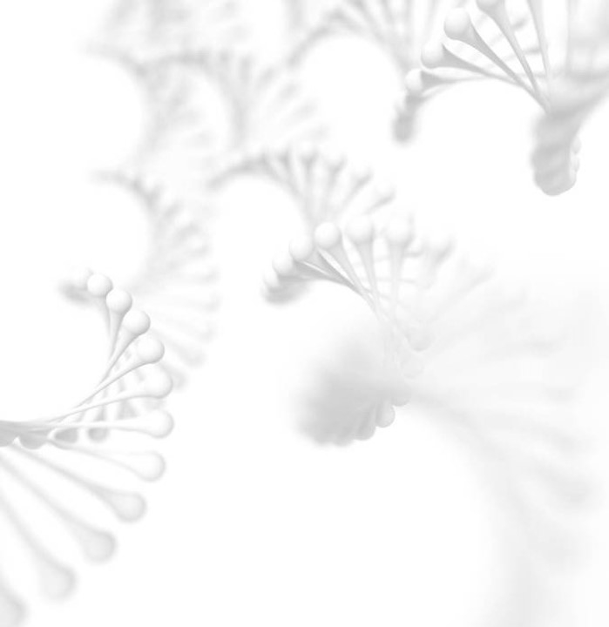
Comparison at 30 and 50 epoch
Figure 12 presents a performance comparison of the proposed model at 30 and 50 epochs against established algorithms, including the Visual Geometry Group (VGG16), Residual Network (ResNet), Traditional-DenseNet, and Convolution Neural Network (CNN). The findings clearly indicate that the proposed model outshines the other algorithms in its performance.

Slide 19
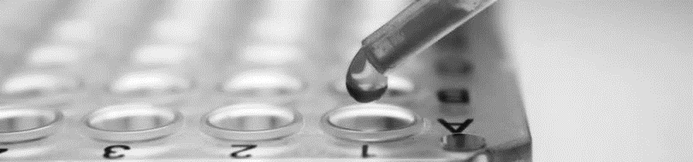
Conclusion
In this innovative study, a model utilizing Deep Learning and CNNs, particularly the DenseNet architecture, is introduced for brain tumor detection and classification from MRI images. Trained on the BrainTumorBD dataset for 50 epochs, the model achieved an outstanding accuracy of 96.51%, outperforming existing systems in true detection while minimizing false positives. Precision, Recall, and F1 Scores were exceptionally high at 96.32%, 95.23%, and 96.38%, respectively.

Slide 20

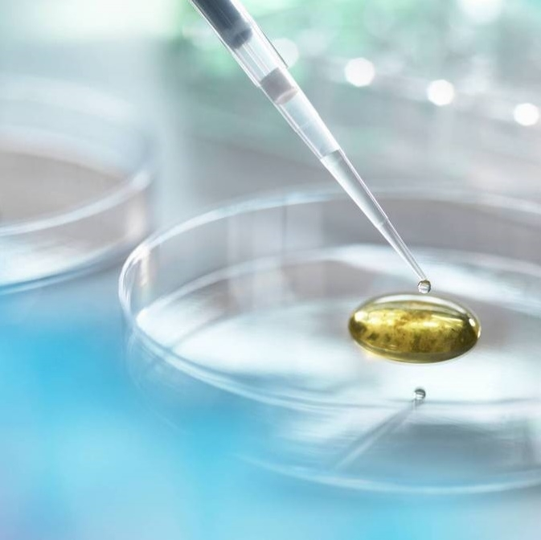
Thank you

